Slide 1


Slide 2

Online Gaming
Introduction
History
Platform and Types
Current Situation
Merits and Demerits
Conclusion
References

Slide 3
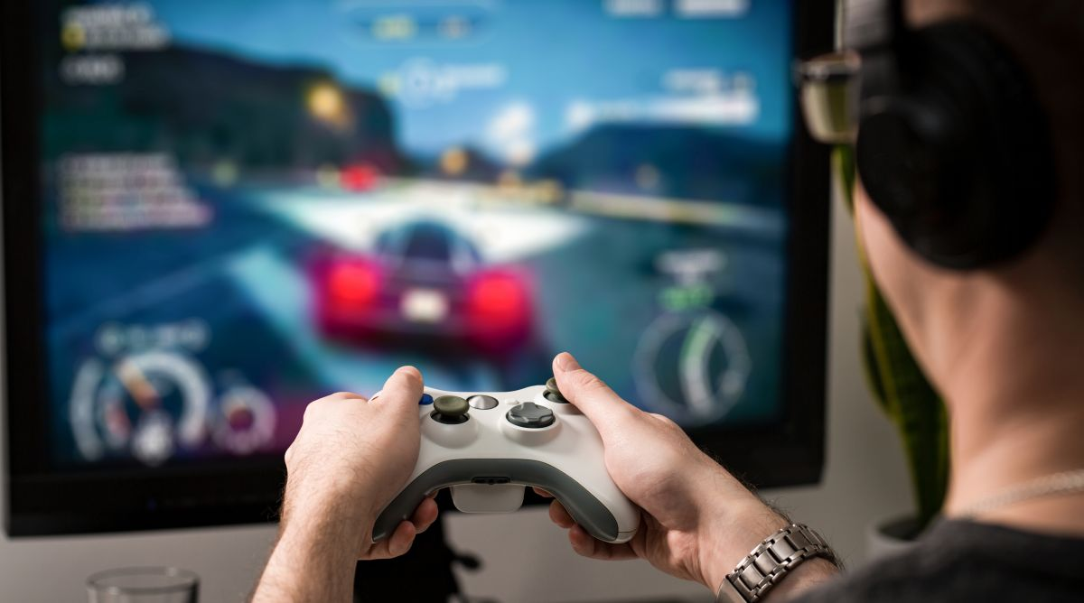
Introduction
Online Games are same as the offline video games but requires internet connection to play. Online games are very popular than the offline games because these games provides more contents and entertainment than the offline games. Not only this but players can also stream their gameplay on social media and can earn money and popularity. Online Game’s design can range form simple text-based environment to complex graphic design and virtual world. The components of the online games can range from minor feature to directly playing against other players. The main entertaining part of the online games are communication between players. Player can play against other players and communicate with the friends and opponent.
The online gaming market is growing bigger year by year because more games are being created and more people are starting to paly. The global online gaming market size is poised to reach USD 79 billion by 2025. it is the fastest trend growing in teenagers and the young population.

Slide 4
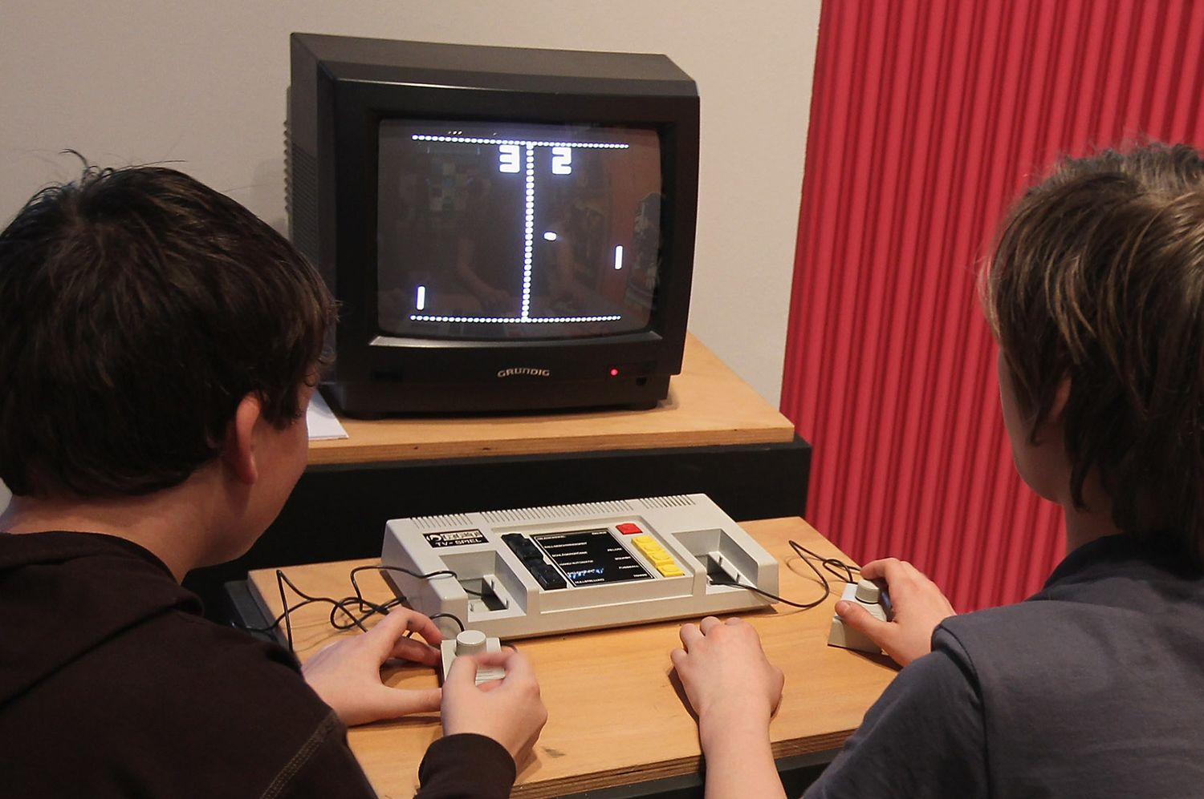
History
The Concept of games was started from the early 1950s when academic computer scientist began designing simple games and simulations as part of their research. Video Gaming reached popularity during the 1970s and 1980s when arcade games and gaming consoles using joysticks, buttons and other controllers along with graphics on computer screens were introduced to general public. Pong is thought to be the first video game created in October 1958 by physicist William Higinbotham. MUD 1 is the first online game created in 1978 but the commercial games followed in the next decade with islands of kesmai the first commercial online role-playing game debuting in 1984.
During the 1990s, the rapid availability of the internet provided an expansion of online games. But it was costly at that time . Entering 2000s, the cost of technology, servers and the internet has dropped and improved connection speeds, new genres games such as social games and new platforms such as mobile games. Then online multiplayer games emerged for example World of Warcraft(2003). Battle arena and battle royal games were made. The battle royale game format became very popular in the late 2010s with the release of Player Unknown’s Battlegrounds(2017), Fortnite Battle Royale(2017). These games were also introduced in mobile platform.

Slide 5
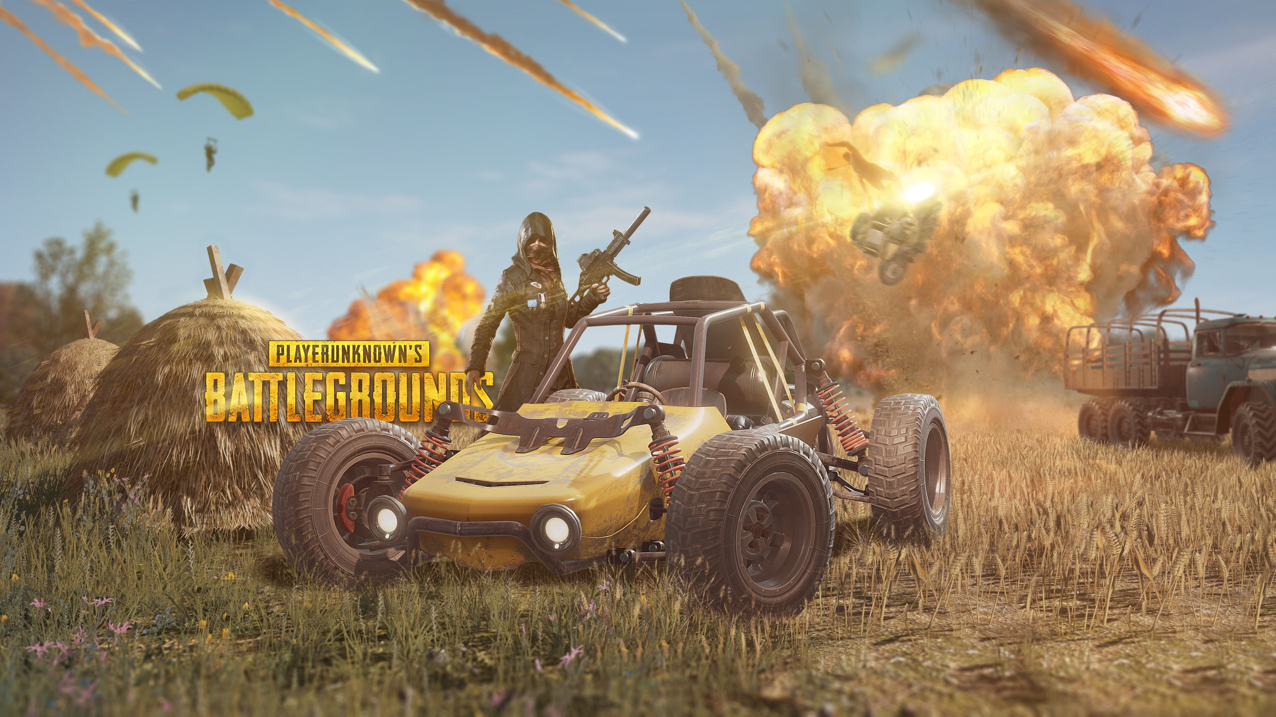


Platform and Types
Mobiles, Computers and Consoles are the most popular online gaming platform and there are different types of games available in the market. Among theme some known are listed below
Action and Racing are very popular gaming category because people gets more funs and entertainments. Fortnite Battle Royale, Player Unknown’s Battleground, Call Of Duty, Apex Legend, Counter-Strike: Global Offensive, DOTA 2 are very popular multiplayer battle Royale games in Computers and Consoles platform. PUBG, COD, Free Fire, Fortnite are popular battle Royale games and Asphalt 9 is racing game in mobile platform. Mobile gaming platform is very popular and cost less than the other platforms.

Slide 6
Current Situation
There are millions of player at the current days having online games account and millions of theme are online 24 hour. Many players streams their gameplay in the social media like YouTube, twitch, Mixer, Nemo Tv etc. to earn popularity and money. People can build career on gaming and many of the players have been successful to be high level gamer. Online game organizations also creates events to compete many players from different counties and the team who weans the game becomes famous. During the expansion of online games, many electronic devices like graphic cards, SSD, RAM, Monitors even Gaming computers, laptops and mobiles price has been dropped. Some pro gamers plays more than one online gaming but most of them focuses on only one. Every player are required lots of time to spend with the game to be very good at it. The trend that the parents restricting their children from playing game is being disappeared because every players now days are being more educated and concerned. At todays condition, anyone can build career on online gaming platform.

Slide 7

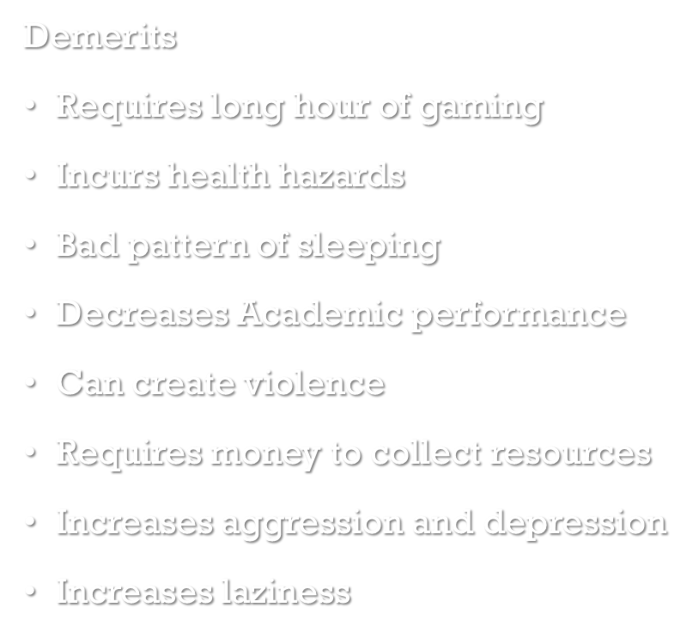
Merits and Demerits
.

Slide 8
Conclusion
Even though online games have many disadvantages, online gaming helps the development of children, gives a fun and exciting way to spend time and develops teem work skills, they can enhance skills such as technology skills that are necessary in today’s life which is constantly changing and growing. But I agree that online gaming does have downside. Parents should limit the time of their children to play games and only allow if all homework and other commitments are completed. Gaming should be a reward not a given.

Slide 9
References
https://en.wikipedia.org/wiki/Video_game
https://en.wikipedia.org/wiki/Online_game
https://en.wikipedia.org/wiki/History_of_video_games
https://pcdreams.com.sg/advantages-and-disadvantages-of-multiplayer-online-games/

